Slide 1
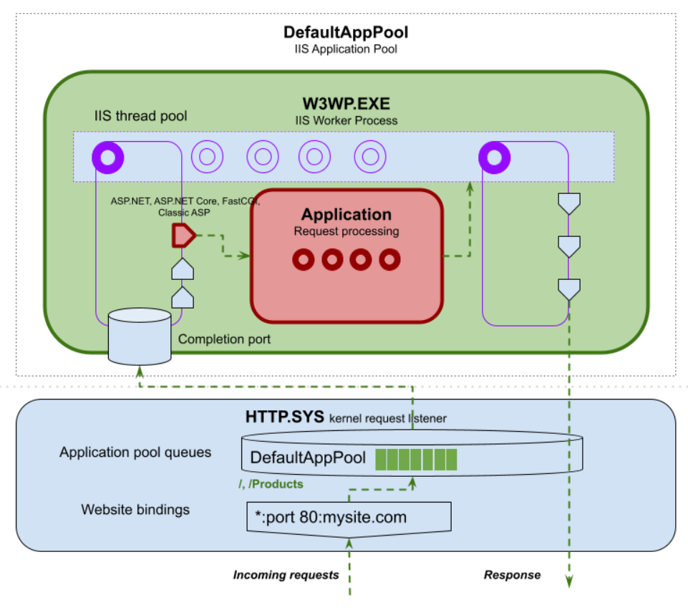
Multi Thread with ASP.NET, Java Spring
Request Work Thread 1
Request Work Thread
Request
Host
Process
(ex : W3WP.EXE)
Request Work Thread
IIS, APACHE
(web server platform, management thread pool)
Request Work Thread
Request Work Thread N
Limitation N Thread
Here, We Call Multi Thread

Slide 2
Non-Blocking Single Thread with Node.js
But, Here, Multi Thread,
Use Thread Pool
Non Blocking Process Chain Thread 1
Here, We Call, Single Thread
Non Blocking Process Chain Thread…
Request
Host
Process
(One TCP Thread)
Non Blocking
Process Chain.
(Event Queue)
Also, Use Thread Pool
Non Blocking Process Chain Thread…
No Limitation N Thread.
Use Queue.
Non Blocking Process Chain Thread…
Non Blocking Process Chain Thread N

Slide 3
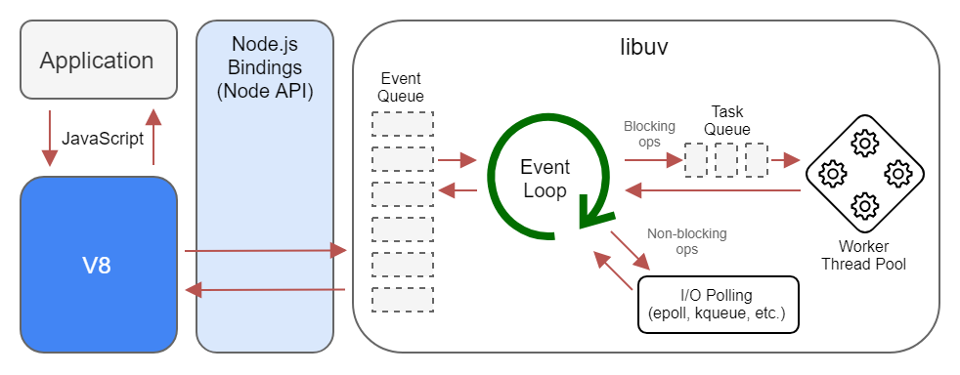
Non-Blocking Single Thread with Node.js
Non Blocking
Process Chain
(Event Queue)
Also, Use Thread Pool
Non Blocking Process Chain Start
Call Chain Method 1
Call Chain Method 2
Call Chain Method N

Slide 4
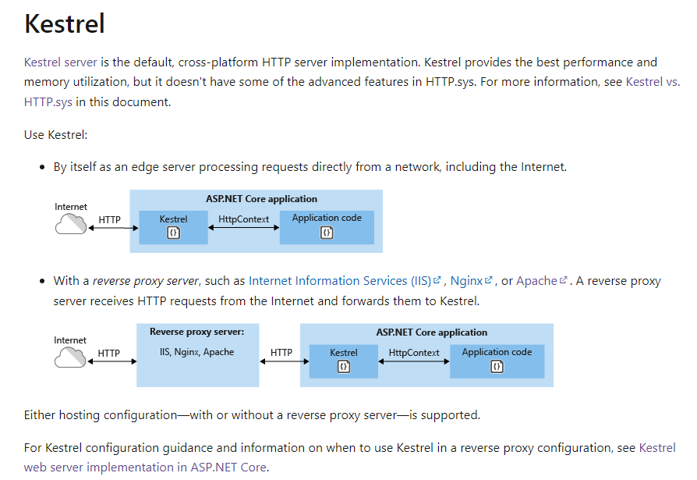
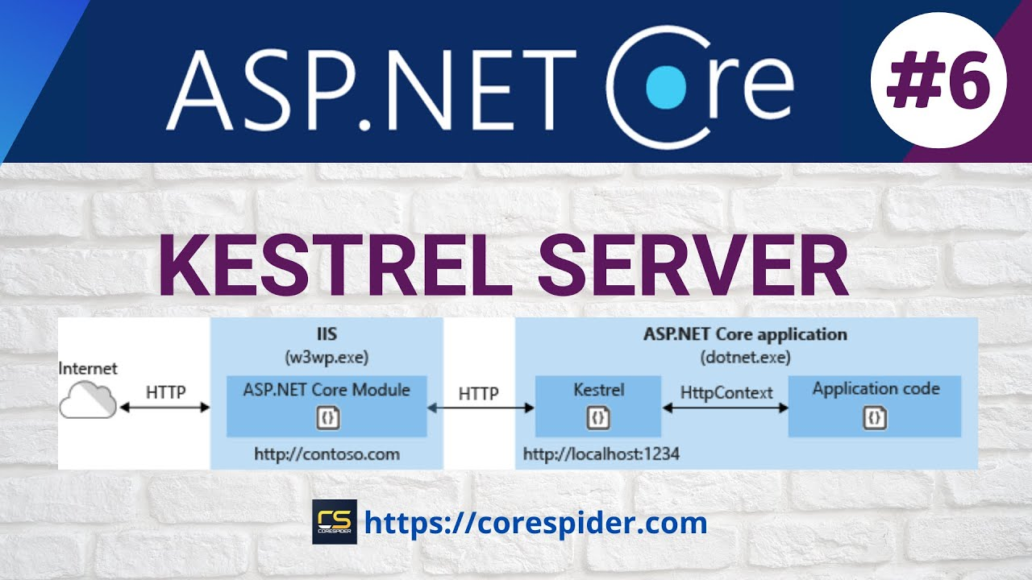
ASP.NET CORE AND ASP.NET 5 HIGHER
ASP.NET Core 2.1 lower, Use libuv. And now, use socket.
Edge web server
Reserve proxy

